Slide 1
Protecting the Safety and Health of Workers
Coronavirus Disease 2019 (COVID-19)
Organization Name
Name of Meeting or Conference
City, State | Date
Speaker Name
Speaker Title
Occupational Safety and Health Administration

Slide 2
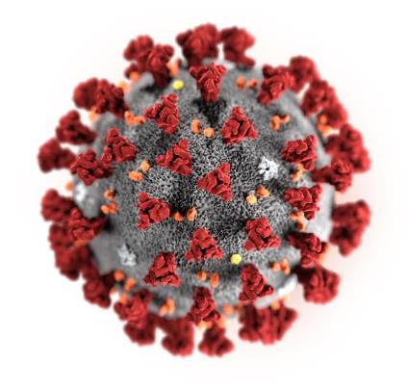
What is novel coronavirus?
Coronaviruses are a family of viruses that can cause illness in people. Coronaviruses circulate among animals, including camels, cattle, and cats.
SARS-CoV-2, the seventh known human coronavirus and the virus that causes COVID-19, is thought to have jumped species from animals to begin infecting humans.
Illustration: CDC / Alissa Eckert & Dan Higgins
www.osha.gov/coronavirus
Notes:
Emphasize terminology used throughout the presentation, and introduced on this slide. SARS-CoV-2 is the viruses that causes the coronavirus disease 2019, known as COVID-19.

Slide 3
How is COVID-19 different from other known coronaviruses?
Several coronaviruses cause common colds, but are not significant threats for most healthy people.
Other coronaviruses have caused past outbreaks, including Severe Acute Respiratory Syndrome (SARS) and Middle East Respiratory Syndrome (MERS)—each caused by a different coronavirus.
SARS-CoV-2 is a distinct coronavirus.
Illustration: CDC / Alissa Eckert & Dan Higgins
www.osha.gov/coronavirus

Slide 4
Signs and symptoms of infection
COVID-19 typically causes mild respiratory illness, but can cause severe disease, including pneumonia-like illness (novel coronavirus-infected pneumonia or NCIP).
Typical symptoms include fever, cough, and shortness of breath.
Symptoms begin 2-14 days after exposure.
Illustration: CDC / Alissa Eckert & Dan Higgins
www.osha.gov/coronavirus

Slide 5
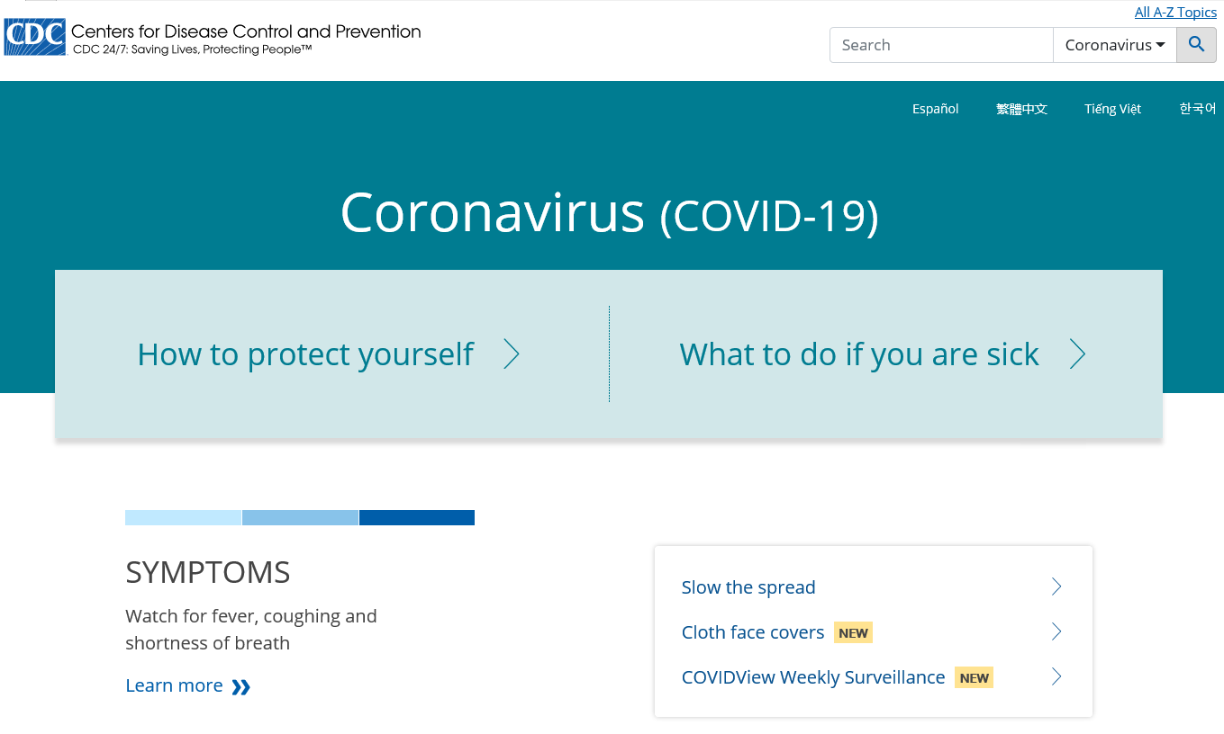
Current pandemic
Latest situation summary:
www.cdc.gov/coronavirus/2019-ncov/
More than 1 million cases worldwide.
Different parts of the U.S. are seeing different levels of COVID-19 activity.
All 50 states have reported cases of COVID-19 to CDC.
www.osha.gov/coronavirus
Notes:
The Centers for Disease Control and Prevention (CDC) website provides the latest information on the pandemic, including countries with cases and, in the United States, states with cases. CDC is also updating its website several times a week to report the number of persons under investigation (PUI) for the virus, as well as positive and negative test results among those people.
This presentation describes OSHA’s current guidance for U.S. workers and employers of workers who are most likely to be at elevated risk of job-related exposure to the virus under the current pandemic conditions. However, employers and workers should monitor changing information on the CDC and OSHA websites to determine if their exposure risks change as the pandemic develops.

Slide 6
Current pandemic
Latest situation summary:
www.cdc.gov/coronavirus/2019-ncov/
U.S. COVID-19 cases include:
  Imported cases in travelers.
  Cases among close contacts of a known case.
  Community-acquired cases where the source of the infection is unknown.
Most U.S. states are reporting community spread of COVID-19.
www.osha.gov/coronavirus

Slide 7
How COVID-19 is spread
Person-to-person spread.
  COVID-19 is thought to spread mainly through close contact from person-to-person in respiratory droplets from someone who is infected. People who are infected often—but not always—have symptoms of illness. People without symptoms are able to spread virus.
Spread from contact with contaminated surfaces or objects.
Latest situation summary:
www.cdc.gov/coronavirus/2019-ncov/
www.osha.gov/coronavirus

Slide 8

If you have been exposed/infected
Prior to seeking treatment, alert your healthcare provider or occupational health clinic if you think you may have COVID-19.
Tell your healthcare provider if you have been exposed to someone with the virus and have signs/symptoms of infection, as well as about any recent travel to areas where COVID-19 is spreading.
Photo: CDC / Scott Housley
www.osha.gov/coronavirus
Notes:
The CDC advises calling ahead to healthcare provider offices, clinics, or hospitals to alert them of a potential COVID-19 case. Some facilities may have specific entrances through which potentially infectious patients should enter, designated waiting areas, and procedures for placing facemasks on such patients to help contain their respiratory secretions.

Slide 9
Diagnosis and treatment
Your healthcare provider can determine if you should be tested for COVID-19.
There is no vaccine or specific treatment for COVID-19.
Some patients, especially those who become very ill, may require supportive care in a hospital.
Photo: CDC / Scott Housley
www.osha.gov/coronavirus
Notes:
As with most infectious diseases, those with underlying conditions, including immunocompromised people, are likely at increased risk of severe disease or death as a result of infection, compared to otherwise healthy adults.

Slide 10
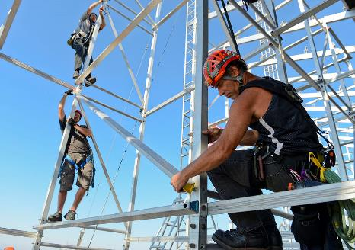
Occupational exposure risks
OSHA is closely coordinating with CDC, including NIOSH, and other agencies to monitor the ongoing pandemic.
The risk of exposure in many workplaces likely reflects the risk to the general public in the community where the workplace is located.
Risk increases when workers have frequent, close contact with the general public or other coworkers.
Photo: U.S. Navy / Seaman Rob Aylward
www.osha.gov/coronavirus

Slide 11

Occupational exposure risks
Workers in some sectors may have increased risk of occupational exposure to SARS-CoV-2, including in:
  Healthcare and Laboratories
  Emergency response
  Mortuary services and other deathcare
  Airline operations
  Border protection and passenger screening
  Critical retail operations (e.g., grocery stores, pharmacies)
Photo: U.S. Customs and Border Protection / James Tourtellotte
www.osha.gov/coronavirus

Slide 12
Existing OSHA standards protect workers from exposure
Relevant OSHA requirements
Personal Protective Equipment (29 CFR 1910 subpart I), including:
  PPE General Requirements (1910.132)
  Eye and Face Protection (1910.133)
  Respiratory Protection (1910.134)
  Hand Protection (29 CFR 1910.138)
Bloodborne Pathogens (29 CFR 1910.1030)
Hazard Communication (29 CFR 1910.1200)
Recordkeeping (29 CFR part 1904)
Follow existing OSHA standards to help protect workers from exposure to SARS-CoV-2 and infection with COVID-19.
Employers should also remember that OSHA can use the General Duty Clause, Section 5(a)(1), of the Occupational Safety and Health Act to ensure that workers are protected from recognized safety and health hazards that may cause serious harm.
www.osha.gov/coronavirus

Slide 13
Exposure risk – very high
Healthcare workers (e.g., doctors, nurses, dentists, paramedics, EMTs) performing or present for aerosol-generating procedures (e.g., intubation, cough induction procedures, bronchoscopies, CPR, some dental procedures and exams, invasive specimen collection) on known or suspected COVID-19 patients.
Healthcare or laboratory personnel collecting or handling specimens from known or suspected COVID-19 patients.
Morgue workers performing autopsies on the bodies of people who are known to have, or suspected of having COVID-19 at the time of their death.
www.osha.gov/coronavirus
Notes:
Very High Exposure Risk jobs are those with high potential for exposure to known or suspected sources of COVID-19 during specific medical, postmortem, or laboratory procedures.

Slide 14
Exposure risk – high
Healthcare delivery and support staff (e.g. doctors, nurses, and other hospital staff who must enter patients rooms) exposed to known or suspected COVID-19 patients. (While NO aerosol generating procedures are being performed.)
Medical transport workers (e.g., ambulance vehicle operators) moving known or suspected COVID-19 patients in enclosed vehicles.
Mortuary workers involved in preparing the bodies of people who are known to have, or suspected of having COVID-19 at the time of their death.
www.osha.gov/coronavirus
Notes:
High Exposure Risk jobs are those with high potential for exposure to known or suspected sources of COVID-19.

Slide 15
Exposure risk – medium
Jobs that require frequent (i.e., more than a few minutes) and/or close (i.e., within 6 feet) contact with people who may be infected with SARS-CoV-2, but who are not known or suspected COVID-19 patients.
Examples include:
  Critical retail workers, such as those in pharmacies and grocery stores.
  Transit workers, such as bus drivers, subway operators, and taxi drivers.
  Workers in other transportation operations.
www.osha.gov/coronavirus

Slide 16
Exposure risk – low (caution)
Jobs that do not require contact with people known to be, or suspected of being infected with SARS-CoV-2 nor frequent close contact with (within 6 feet) of the general public.
Workers in this category have minimal occupational contact with the public and other coworkers.
www.osha.gov/coronavirus

Slide 17
OSHA enforcement
OSHA enforcement authority
During emergency response operations, even when OSHA is operating in a technical assistance and support mode, OSHA standards remain in effect and OSHA retains its ability to enforce the OSHA standards under the OSH Act.
Enforcement of OSHA standards follows the jurisdiction in place before the emergency, such as in states operating OSHA-approved occupational safety and health programs called State Plans.
OSHA:
Typically responds to emergencies, including disease outbreaks, in a technical assistance posture.
Provides compliance assistance to employers to help ensure workers are protected.
Provides technical assistance and support to other federal agencies, as well as state/local partners.
www.osha.gov/coronavirus
Notes:
DOL/OSHA is the coordinating agency for the Worker Safety and Health Support Annex to the National Response Framework. OSHA and the cooperating agencies listed in the Worker Safety and Health Support Annex can assist local, state, federal, tribal, territorial, and insular area agencies with:
Risk assessment and management
Identification, assessment, and control of health and safety hazards
Development and oversight of health and safety plans (HASPs)
Worker exposure monitoring, sampling, and analysis
Personal protective equipment (PPE) program development and implementation, including monitoring, selection, fit-testing (e.g., for respirators), and decontamination
Incident-specific worker safety and health training
Communication of safety and health information to workers and employers

Slide 18
OSHA enforcement discretion
Memorandum | Effective
Healthcare Respiratory Protection Annual Fit-Testing for N95 Filtering Facepieces During the COVID-19 Outbreak | March 14, 2020 - present
Enforcement Guidance for Respiratory Protection and the N95 Shortage Due to the 2019 Novel Coronavirus Disease (COVID-19) Pandemic | April 3, 2020 – present
Enforcement Guidance for Use of Respiratory Protection Equipment Certified Under Standards of Other Countries or Jurisdictions During the Coronavirus Disease 2019 (COVID-19) Pandemic | April 3, 2020 - present
Expanded Temporary Enforcement Guidance on Respiratory Protection Fit-Testing for N95 Filtering Facepieces in All Industries During the Coronavirus Disease (COVID-19) Pandemic | April 8, 2020 - present
Enforcement Guidance for Recording Cases of Coronavirus Disease 2019 (COVID-19) | April 10, 2020 - present
OSHA has provided enforcement discretion for some of its requirements, including:
Respiratory Protection standard (29 CFR 1910.134)
Other health standards with respirator requirements
Recording and Reporting Occupational Injuries and Illness (29 CFR Part 1904)
www.osha.gov/coronavirus
Notes:
OSHA recognizes that employers in many sectors may experience challenges in complying with certain provisions of the agency’s standards as a result of the COVID-19 pandemic, including where those standards require the use of certain types of PPE (e.g., respirators) or provision of medical surveillance and training to workers. Accordingly, OSHA is providing enforcement flexibilities for specific provisions of certain standards to address these challenges and help ensure the continued protection of worker safety and health.
This enforcement guidance is intended to be time-limited to the current public health crisis. Please frequently check OSHA’s webpage at www.osha.gov/coronavirus for updates.

Slide 19
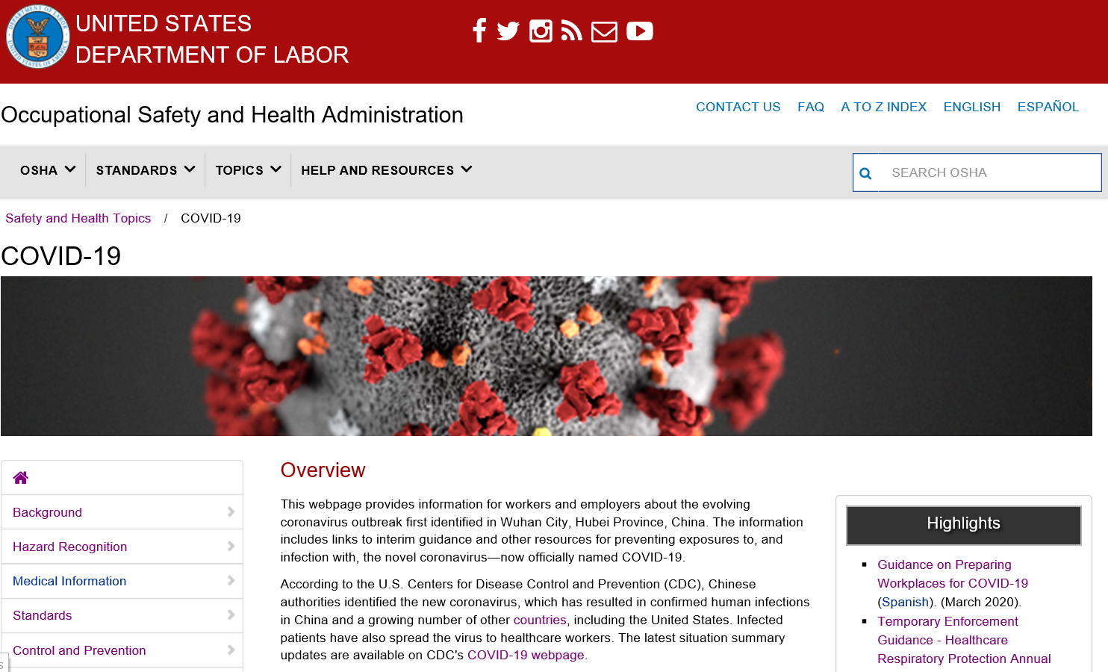
OSHA guidance
OSHA has developed a variety of guidance materials for workers and employers on how to stay healthy during the pandemic.
OSHA.gov/coronavirus includes information on implementing the hierarchy of controls when workers have specific exposure risks.
www.osha.gov/coronavirus
Notes:
In addition to the COVID-19 Safety and Health Topics page, OSHA is also providing a number of alerts, a booklet produced jointly with the U.S. Department of Health and Human services, and other materials to help workers and employers, including in the sectors where exposure to the virus may be most likely. These materials are all available from the OSHA.gov/coronavirus page.
You can find additional resources from the Coronavirus Task Force at coronavirus.gov and the U.S. Department of Labor at dol.gov/coronavirus.

Slide 20
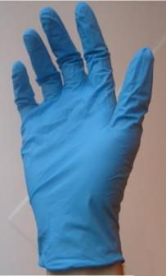
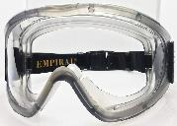
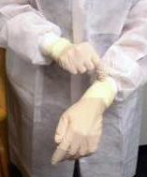
OSHA guidance
Clockwise from L: public domain; WikimediaCommons;
CDC/Kimberly Smith & Christine Ford
OSHA guidance helps employers comply with OSHA standards.
Guidance is based on anticipated hazards and risks, and incorporates standard, contact, and airborne precautions, and use of face/eye protection.
Guidance should be adapted based on employer’s hazard assessment and workers’ tasks.
www.osha.gov/coronavirus
Notes:
List N: Disinfectants for Use Against SARS-CoV-2 – https://www.epa.gov/pesticide-registration/list-n-disinfectants-use-against-sars-cov-2
List N includes products that meet EPA’s criteria for use against SARS-CoV-2, the cause of COVID-19.
This list includes products with emerging viral pathogen claims and those with human coronavirus claims. If a product with an emerging viral pathogen claim is not available, use a product with a coronavirus claim. If the product is listed as “N” under the Emerging Viral Pathogen Claim column, then it has a human coronavirus claim.

Slide 21
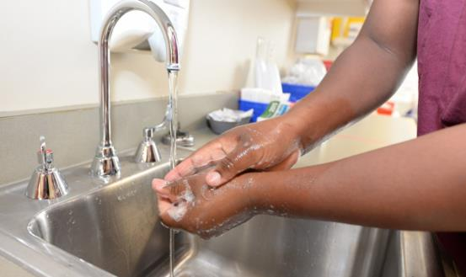
OSHA guidance
For all workers, regardless of specific exposure risks:
  Practice good and frequent hand hygiene.
  Follow good cough/sneeze etiquette.
  Avoid touching the eyes, nose, or mouth with unwashed hands.
  Avoid close contact with people who are sick.
Photo: U.S. Department of Defense
www.osha.gov/coronavirus
Notes:
For all workers, regardless of specific exposure risks, it is always a good practice to:
Frequently wash your hands with soap and water for at least 20 seconds. When soap and running water are unavailable, use an alcohol-based hand rub with at least 60% alcohol. Always wash hands that are visibly soiled.
Follow good cough etiquette by covering your mouth when coughing and sneezing, such as by using disposable tissues or coughing/sneezing into the elbow.
Avoid touching your eyes, nose, or mouth with unwashed hands.
Avoid close contact with people who are sick.

Slide 22
OSHA guidance
Employers should implement protocols for regularly cleaning and disinfecting high-touch surfaces in the work environment.
  Wipe down surfaces such as door push bars, shopping carts, points of sale, chairs in waiting areas, and other areas that customers, visitors, or workers frequently touch.
Follow manufacturer’s instructions for use of all EPA-approved cleaning and disinfection products.
CDC provides detailed guidance for environmental cleaning and disinfection.
www.osha.gov/coronavirus

Slide 23
OSHA guidance
Train all workers about their risk of occupational exposure to COVID-19 as well as on what to do if they have traveled to high-risk areas or been exposed to possible cases.
For workers at particular risk of exposure (e.g., in healthcare, others), discuss:
  Sources of exposure to the virus and hazards associated with that exposure.
  Appropriate ways to prevent or reduce the likelihood of exposure, including use of engineering and administrative controls, safe work practices, and PPE.
Some OSHA standards (e.g., BBP, PPE) require worker training.
www.osha.gov/coronavirus
Notes:
Workers required to use PPE must be trained. This training includes when to use PPE; what PPE is necessary; how to properly don (put on), use, take off PPE; how to properly dispose of or disinfect, inspect for damage and maintain PPE; and the limitations of PPE. Applicable standards include the PPE (29 CFR 1910.132), Eye and Face Protection (29 CFR 1910.133), Hand Protection (29 CFR 1910.138), and Respiratory Protection (29 CFR 1910.134) standards. The OSHA website offers a variety of training videos on respiratory protection.
When the potential exists for exposure to human blood, certain body fluids, or other potentially infectious materials, workers must receive training required by the Bloodborne Pathogens (BBP) standard (29 CFR 1910.1030), including information about how to recognize tasks that may involve exposure and the methods, such as engineering controls, work practices, and PPE, to reduce exposure. Further information on OSHA's BBP training regulations and policies is available for employers and workers on the OSHA Bloodborne Pathogens and Needlestick Prevention Safety and Health Topics page.

Slide 24
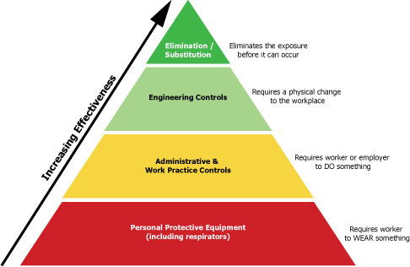
OSHA guidance
For U.S. workers and employers of workers with potential occupational exposures to COVID-19:
  Identify and isolate suspected cases.
  Implement other precautions appropriate for the worksite and job tasks, and according to the hierarchy of controls.
www.osha.gov/coronavirus
Notes:
In all workplaces where exposure to the SARS-CoV-2 may occur, prompt identification and isolation of potentially infectious individuals is a critical first step in protecting workers, visitors, and others at the worksite.
Immediately isolate the person. For example, move potentially infectious people to isolation rooms and close the door. On an aircraft, move potentially infectious people to a seat away from passengers and crew, if possible and without compromising aviation safety. In other worksites, move potentially infectious people to a location away from workers, customers, and other visitors.
Take steps to limit spread of the person’s infectious respiratory secretions, including by providing them a facemask and asking them to wear it, if they can tolerate doing so. Note: A surgical mask on a patient or other sick person should not be confused with PPE for a worker; the mask acts to contain potentially infectious respiratory secretions at the source (i.e., the person’s nose and mouth).
If possible, isolate people suspected of having COVID-19 separately from those with confirmed cases of the virus to prevent further transmission in screening, triage, or healthcare facilities.
Restrict the number of personnel entering the room of a patient with suspected/confirmed COVID-19.
Protect workers in close contact* with the sick person by using additional engineering and administrative control, safe work practices and PPE.

Slide 25
OSHA guidance
What should standard, contact, and airborne precautions consist of in workplaces where workers may be exposed to COVID-19? OSHA guidance breaks this down by worker type.
  Engineering controls, such as isolation rooms and other physical barriers, can limit most workers’ exposures.
  Administrative controls and safe work practices include measures such as limiting access to patient care areas, effective sharps management, and worker training.
  PPE may include gloves, gowns, goggles or face shields, and N95 or better respirators.
www.osha.gov/coronavirus
Notes:
OSHA and CDC recommend respiratory protection for certain workers who have close contact with potentially infectious people, including healthcare, border protection, and screening workers tending to persons under investigation (PUI) for COVID-19 and those providing care for suspected or confirmed patients. Standard biosafety practices in BSL-2 and BSL-3 microbiological laboratories—including clinical labs—also call for respiratory protection for certain activities, including any tasks that may generate aerosols.
Whenever needed, use respiratory protection, including NIOSH-certified disposal N95 filtering facepiece or better (e.g., elastomeric APRs with N95 particulate cartridges, PAPRs with N100/HEPA filters) respirators, as part of a comprehensive, written respiratory protection program that meets the requirements of OSHA’s Respiratory Protection standard (29 CFR 1910.134) and includes medical exams, fit testing, and training.
OSHA has released enforcement memoranda detailing enforcement discretion around the Respiratory Protection standard, including cases in which employers may consider re-use or extended use of N95 filtering facepiece respirators (FFRs), other NIOSH-certified FFRS, elastomeric APRs, PAPRs, respiratory protection equipment that was previously NIOSH-certified by that has exceeded its manufacturer’s recommended shelf-life, and respiratory protection equipment certified in accordance with the standards from other countries or jurisdictions. See www.osha.gov/enforcementmemos for complete details.

Slide 26
OSHA guidance – recordkeeping exposures to COVID-19
COVID-19 can be a recordable illness if a worker is infected as a result of performing their work-related duties. However, employers are only responsible for recording cases of COVID-19 if all of the following are met:
  The case is a confirmed case of COVID-19 (see CDC information on persons under investigation and presumptive positive and laboratory-confirmed cases of COVID-19);
  The case is work-related, as defined by 29 CFR 1904.5; and
  The case involves one or more of the general recording criteria set forth in 29 CFR 1904.7 (e.g., medical treatment beyond first-aid, days away from work).
OSHA is providing enforcement discretion around recordkeeping for most sectors.
Visit OSHA’s Injury and Illness Recordkeeping and Reporting Requirements page for more information.
www.osha.gov/coronavirus
Notes:
Under OSHA’s recordkeeping requirements, COVID-19 is a recordable illness, and employers are responsible for recording cases of COVID-19, if:
the case is a confirmed case of COVID-19, as defined by Centers for Disease Control and Prevention (CDC);
the case is work-related as defined by 29 CFR § 1904.5; and
the case involves one or more of the general recording criteria set forth in 29 CFR § 1904.7.
On March 11, the World Health Organization (WHO) declared COVID-19 a global pandemic, and the extent of transmission is a rapidly evolving issue.
In areas where there is ongoing community transmission, employers other than those in the healthcare industry, emergency response organizations (e.g., emergency medical, firefighting, and law enforcement services), and correctional institutions may have difficulty making determinations about whether workers who contracted COVID-19 did so due to exposures at work. In light of those difficulties, OSHA is exercising its enforcement discretion in order to provide certainty to the regulated community.
Employers of workers in the healthcare industry, emergency response organizations (e.g., emergency medical, firefighting, and law enforcement services), and correctional institutions must continue to make work-relatedness determinations pursuant to 29 CFR § 1904. Until further notice, however, OSHA will not enforce 29 CFR § 1904 to require other employers to make the same work-relatedness determinations, except where:
There is objective evidence that a COVID-19 case may be work-related. This could include, for example, a number of cases developing among workers who work closely together without an alternative explanation; and
The evidence was reasonably available to the employer. For purposes of this memorandum, examples of reasonably available evidence include information given to the employer by employees, as well as information that an employer learns regarding its employees’ health and safety in the ordinary course of managing its business and employees.
This enforcement policy will help employers focus their response efforts on implementing good hygiene practices in their workplaces, and otherwise mitigating COVID-19’s effects, rather than on making difficult work-relatedness decisions in circumstances where there is community transmission.

Slide 27
For continual updates
Visit OSHA’s website to sign up to receive OSHA information:
  QuickTakes biweekly newsletter
  Tip of the Day
  www.osha.gov/contactus
Follow OSHA on social media
  Twitter: @OSHA_DOL
  Facebook: Follow the Department of Labor page
www.osha.gov/coronavirus

Slide 28
Questions?
[Speaker]
OSHA [Directorate/Region/Area]
Email:
Phone:
OSHA Directorate of Technical Support and Emergency Management
Phone: 202-693-2300
www.osha.gov/coronavirus

Slide 29
OSHA
www.osha.gov
1-800-321-OSHA (6742)

Slide 30
Slides after this point are intended to help presenters answer additional questions from workers, employers, and other audiences. They are not included in the main slide deck, as the content is more complex or of narrower interest.

Slide 31
Additional Q&A
Q: Why does OSHA recommend goggles in addition to airborne precautions?
A: Precautions for SARS-CoV-2 are based on evolving epidemiologic evidence of how the virus spreads, and what is known about transmission from SARS and MERS outbreaks.
Airborne precautions, including the use of NIOSH-certified N95 or better respirators, are appropriate because the virus may be spread through a range of respirable particle sizes.
Since SARS-CoV-2 may infect people through mucous membranes of the eyes and face, face/eye protection is also needed.
www.osha.gov/coronavirus
Notes:
Note that OSHA has released enforcement memoranda detailing enforcement discretion around the Respiratory Protection standard, including cases in which employers may consider re-use or extended use of N95 filtering facepiece respirators (FFRs), other NIOSH-certified FFRS, elastomeric APRs, PAPRs, respiratory protection equipment that was previously NIOSH-certified by that has exceeded its manufacturer’s recommended shelf-life, and respiratory protection equipment certified in accordance with the standards from other countries or jurisdictions. See www.osha.gov/enforcementmemos for complete details.

Slide 32
Additional Q&A
Q: Do OSHA and CDC guidelines for healthcare and other workers align?
A: Both agencies’ worker-focused guidance is intended to help protect workers from exposure to SARS-CoV-2 spread via respiratory sections, including as a result of exposure to infectious individuals or to exposure to contaminated surfaces.
CDC guidance for some sectors, such as healthcare, reflects the realities of ongoing PPE supply chain shortages. OSHA continues to recommend what it believes are the best methods to protect workers, but is providing enforcement discretion to address those supply chain concerns, as well.
www.osha.gov/coronavirus

Slide 33
Additional Q&A
Q: Clinical samples of sputum are not covered by the BBP standard’s universal precautions. How should employers protect workers handling these samples?
A: While universal precautions do not apply to sputum in the BBP standard, standard precautions that CDC introduced to protect healthcare workers from a wider range of pathogens, do. Follow standard and transmission-based (contact + airborne) precautions.
OSHA and CDC infection prevention recommendations are more protective than the minimum precautions the BBP standard requires.
www.osha.gov/coronavirus

Slide 34
Additional Q&A
Q: SARS-CoV-2 is not a bloodborne pathogen, so does the BBP standard apply?
A: The BBP standard applies to occupational exposure to blood, certain body fluids, and other potentially infectious materials, as defined in the standard.
Even though SARS-CoV-2 is a respiratory virus, workers in healthcare and other sectors may still have occupational exposures covered by the standard.
In those cases, employers must comply with the provisions of the standard.
www.osha.gov/coronavirus

Slide 35
Additional Q&A
Q: Do I have to record cases of COVID-19 on my entity’s OSHA 300, 300A, & 301 forms?
A: OSHA recordkeeping requirements at 29 CFR Part 1904 mandate covered employers record certain work-related injuries and illnesses on their OSHA 300 log.
While 29 CFR 1904.5(b)(2)(viii) exempts recording of the common cold and flu, COVID-19 is a recordable illness when a worker is infected on the job.
Find additional injury and illness recordkeeping information at OSHA.gov.
www.osha.gov/coronavirus
Notes:
COVID-19 can be a recordable illness if a worker is infected as a result of performing their work-related duties. However, employers are only responsible for recording cases of COVID-19 if all of the following are met:
1.The case is a confirmed case of COVID-19 (see CDC information on persons under investigation and presumptive positive and laboratory-confirmed cases of COVID-19);
2.The case is work-related, as defined by 29 CFR 1904.5; and
3.The case involves one or more of the general recording criteria set forth in 29 CFR 1904.7 (e.g., medical treatment beyond first-aid, days away from work).
Visit OSHA’s Injury and Illness Recordkeeping and Reporting Requirements page for more information.

Slide 36
Additional Q&A
Q: How does the COVID-19 pandemic compare to previous coronavirus outbreaks, such as SARS in 2002-2003?
A: The SARS outbreak was caused by a different coronavirus than the one causing the ongoing outbreak.
However, there are already more COVID-19 cases than there were SARS cases during its 2002-2003 outbreak.
www.osha.gov/coronavirus

